Slide 1
NSS 2016 10th International Conference on Network and System Security TAIPEI, TaiWan

Slide 2
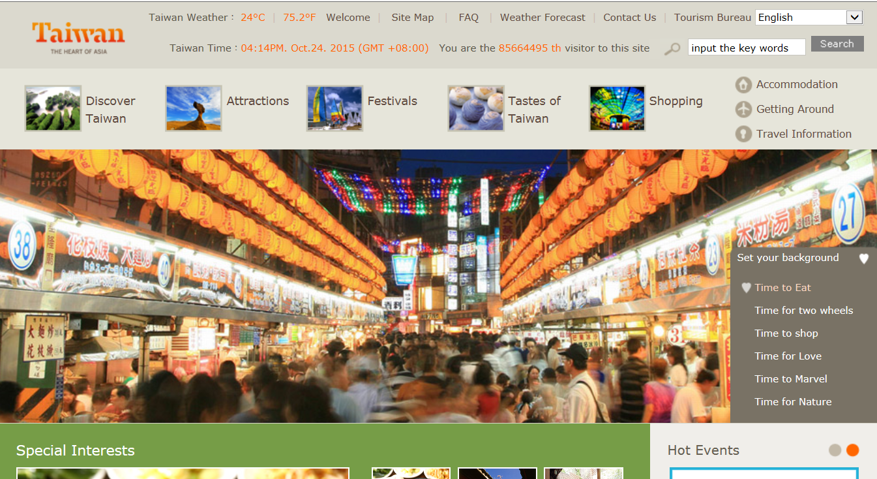
Introduction of Taiwan and Taipei
http://eng.taiwan.net.tw/

Slide 3
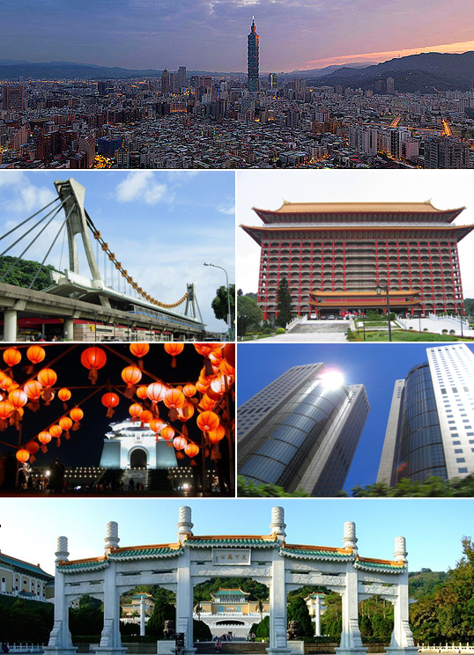
Taipei, Capital City of Taiwan

Slide 4
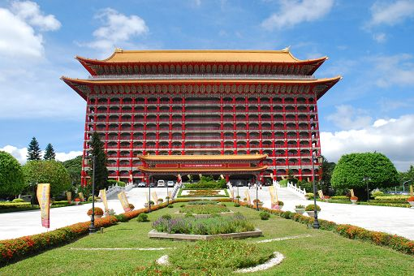
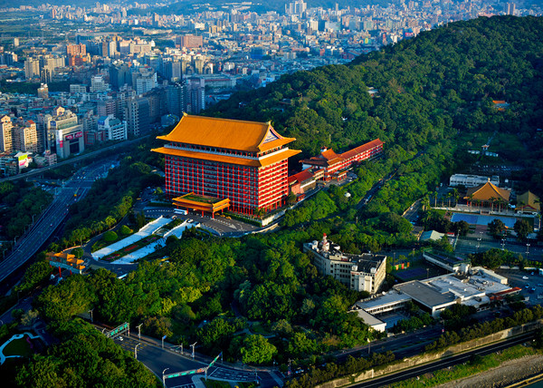
NSS 2016
Tentative Date: 28-30 September, 2016
Tentative Venue: The Grand Hotel
http://www.grand-hotel.org/taipei/en/?Psn=5301

Slide 5
Organization of NSS 2016 (1/2)
Host: The Chinese Cryptology and Information Security Association (CCISA).
Honorary Chairs:
Der-Tsai Lee, Academia Sinica, Taiwan
D. J. Guan, National Sun Yat-sen University, Taiwan
Yen-Nun Huang, Academia Sinica, Taiwan
General Chairs:
Shiuhpyng (Winston) Shieh, National Chiao Tung University, Taiwan
Tzong-Chen Wu, National Taiwan University of Science and Technology, Taiwan
Chun-I Fan, National Sun Yat-sen University, Taiwan
Nai-Wei Lo, National Taiwan University of Science and Technology, Taiwan

Slide 6
Organization of NSS 2016 (2/2)
Executive Chairs:
Wen-Chung Kuo, National Yunlin University of Science and Technology, Taiwan
Chen-Mou (Doug) Cheng, National Taiwan University, Taiwan
Kuo-Hui Yeh, National Dong Hwa University, Taiwan
Contact person:
Kuo-Hui Yeh, khyeh@mail.ndhu.edu.tw

Slide 7
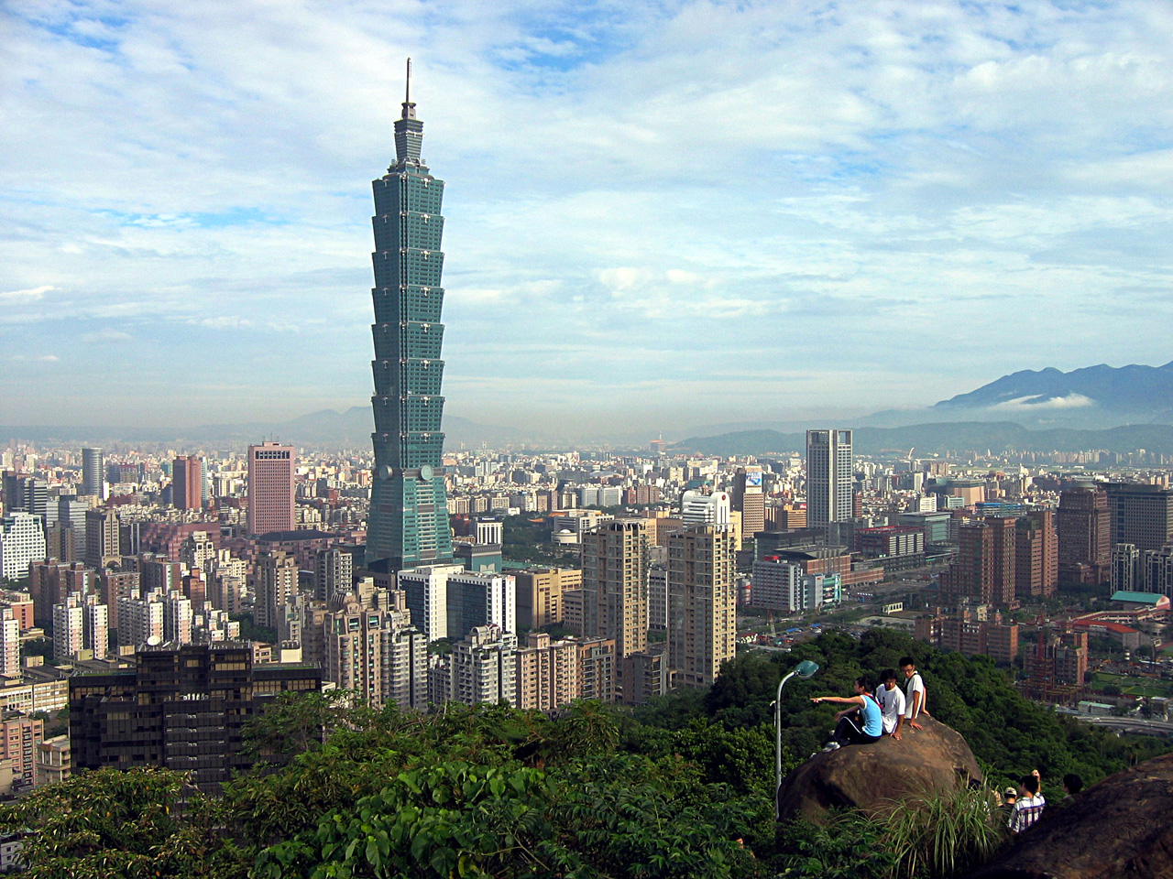
Taipei 101

Slide 8
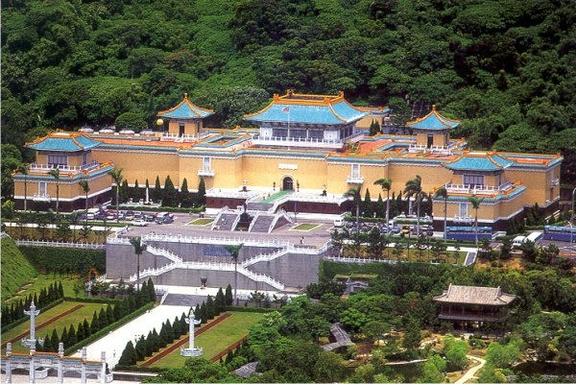
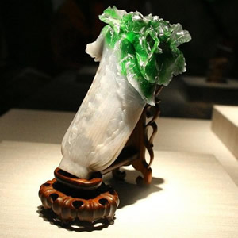
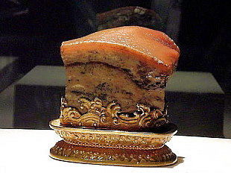
National Palace Museum

Slide 9
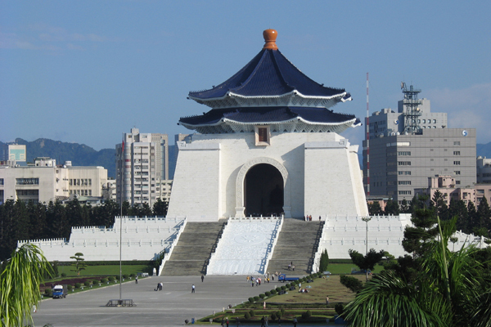
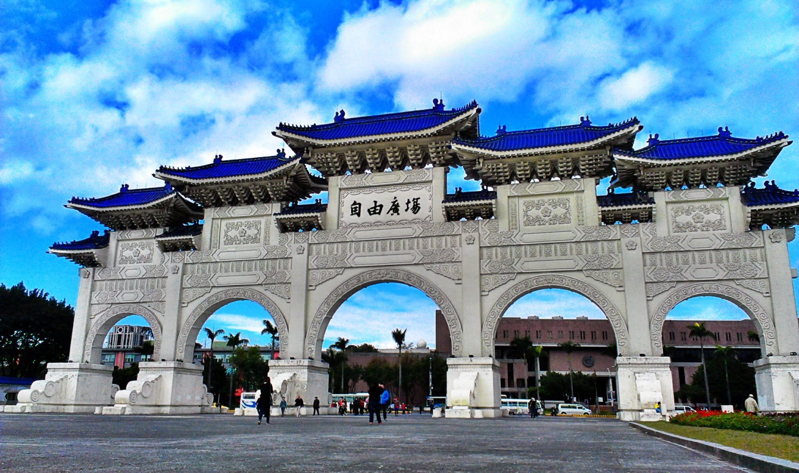
Chiang Kai-shek Memorial Hall

Slide 10
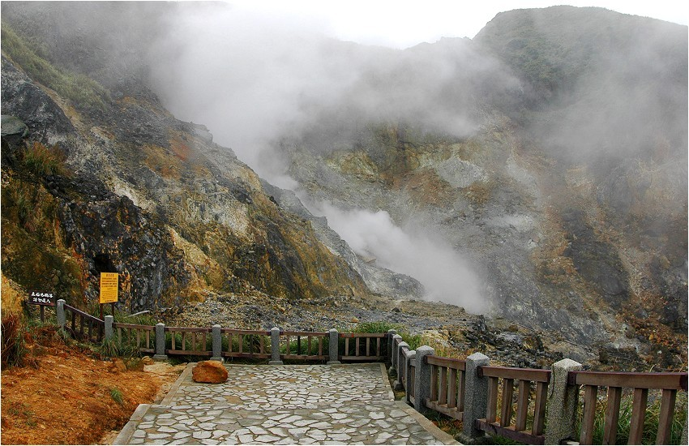
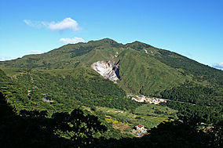
Yangmingshan National Park

Slide 11
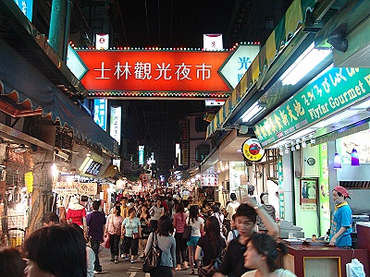
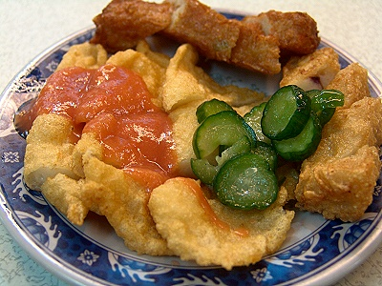
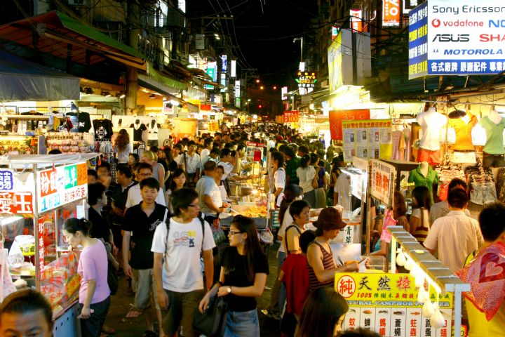
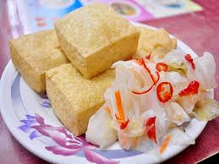
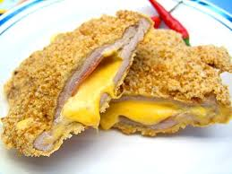
Shilin Night Market

Slide 12
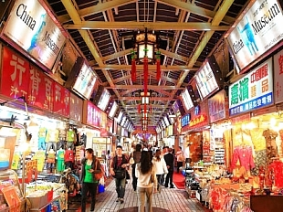
Huaxi Street Tourist Night Market

Slide 13
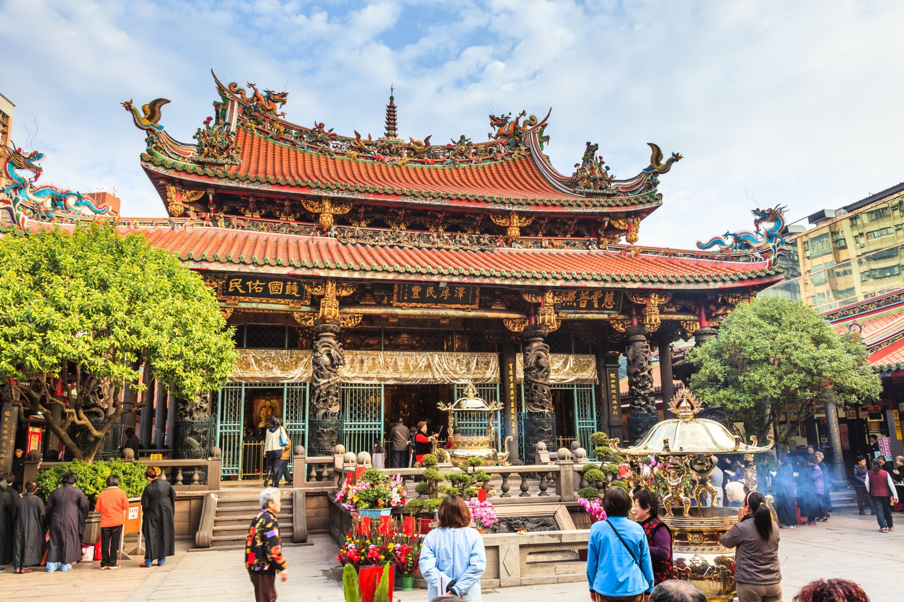
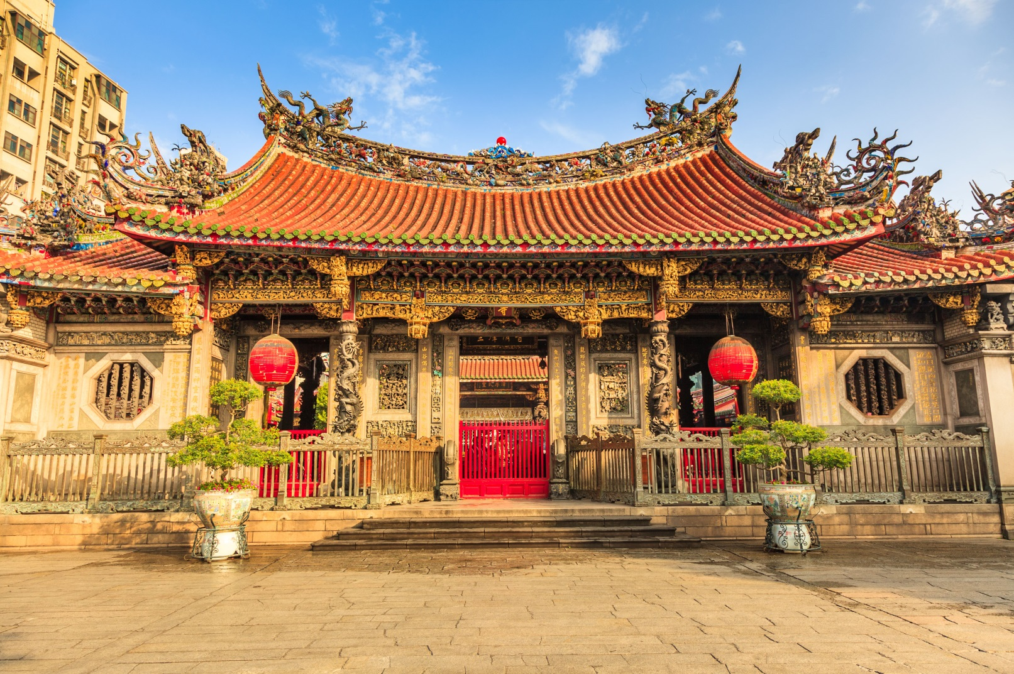
Longshan Temple

Slide 14
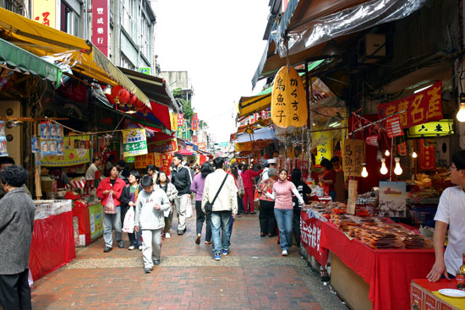
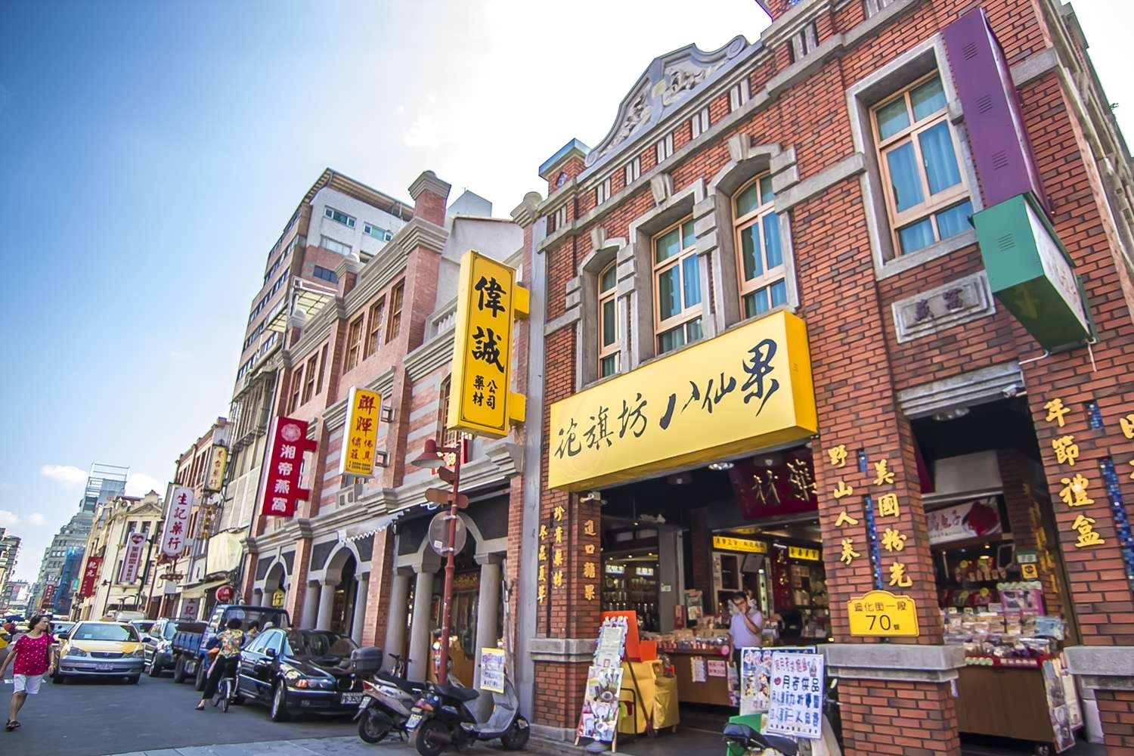
Dihua Street

Slide 15
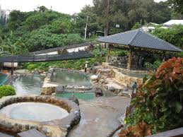
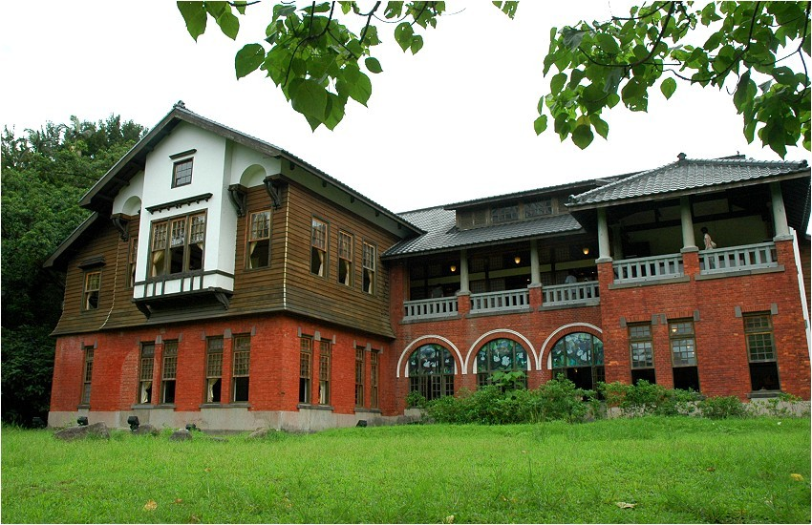
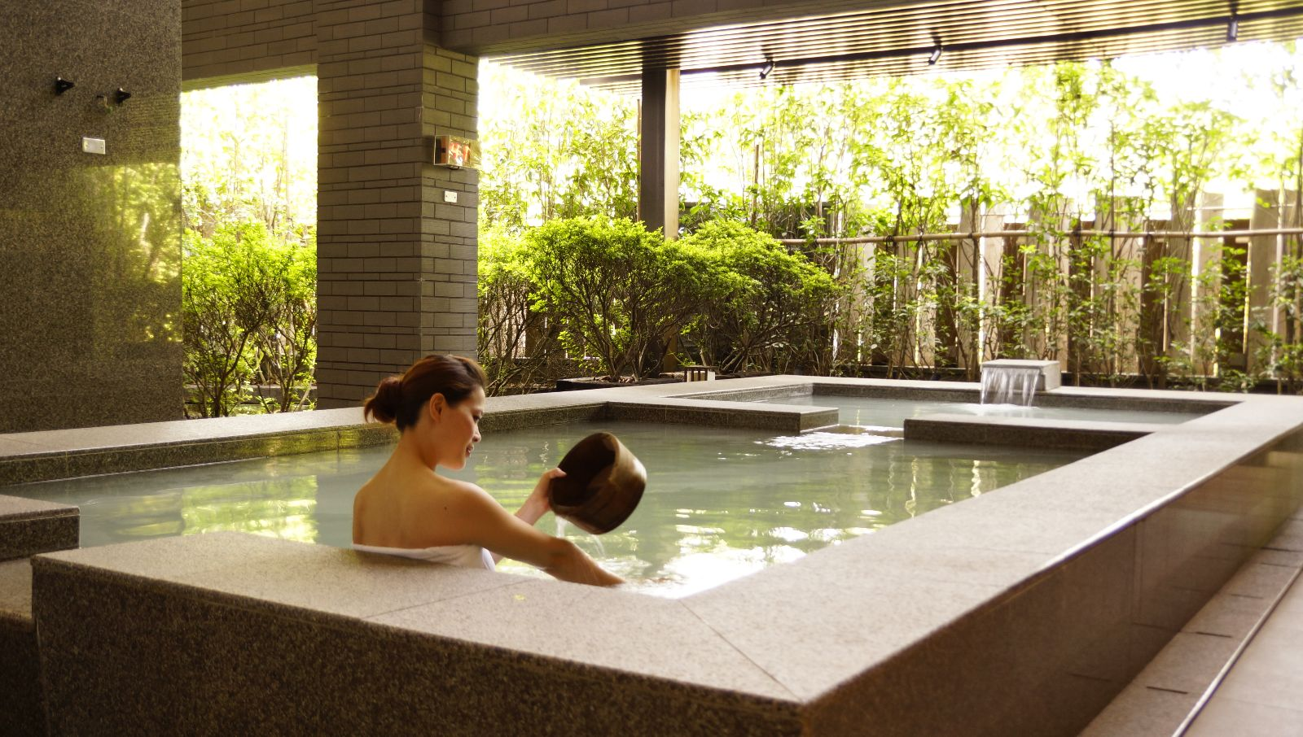
Beitou Hot Springs

Slide 16
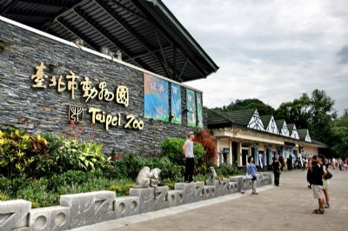
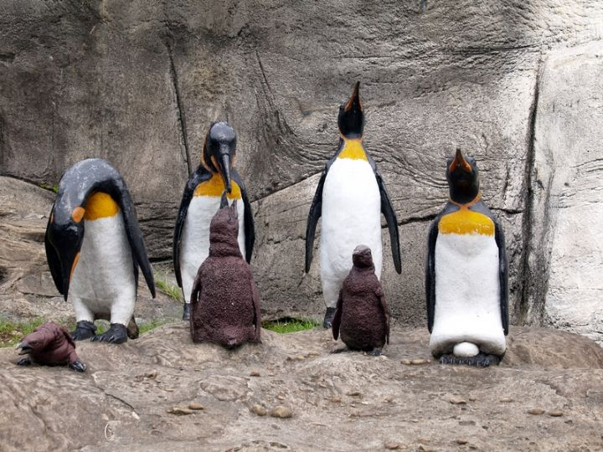
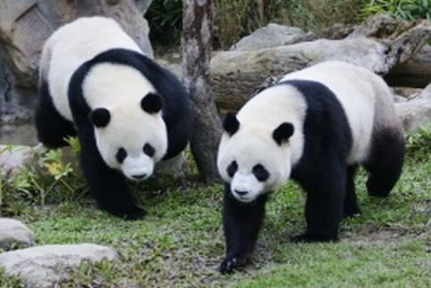
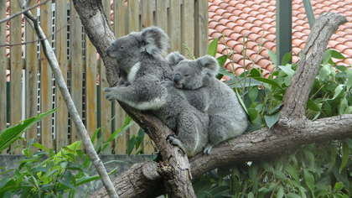
Taipei Zoo

Slide 17
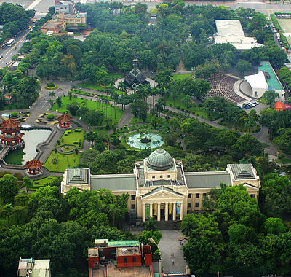
228 Peace Memorial Park

Slide 18
Look Forward to Your Arrival

